Slide 1
Fake News Detection using MLOps
Title: End-to-End ML Workflow with Automation
Team Members:
Anmol (Team Lead) - 250250125012
Dushyant Baghel - 250250125018
Vikrant Tyagi - 250250125070
Aditya Vats - 250250125007
Aman Panchal - 250250125008

Slide 2
Agenda
Project Overview
Part 1: Data Cleaning & Preprocessing
Part 2: Model Training & Evaluation
Part 3: CI/CD Pipeline using GitHub Actions
Part 4: Web Application
Part 5: Visualizations & Notebook
Conclusion & Future Scope

Slide 3
Project Overview
Objective:
Detect fake news articles using NLP and machine learning models in an
automated MLOps pipeline.
Technologies used:
Python - Pandas, Matplotlib, Seaborn, Flask
Scikit-learn: Logistic Regression, Decision Tree
TensorFlow, LSTM, TF-IDF, Ensemble Model
Git, GitHub Actions: Code QL, Trivy Scan
Docker
Jupyter Notebook / Google Colab

Slide 4
Part 1 – Data Cleaning & Preprocessing
Why it's important: Garbage in = Garbage out Steps followed:
Removed null values
Converted text to lowercase
Removed punctuations and special characters
Added new features: word_count, character_count
Parsed and validated publish_date

Slide 5
# Clean the dataset based on given rules
import pandas as pd
def clean_data(df):
try:
# 1. Keep only the specified columns
required_columns = ['Index', 'News Headline', 'Complete News', 'Fake News(Yes/No)', 'word_count', 'character_count', 'Publish Dates', 'Source']
if list(df.columns) != required_columns:
print("Columns do not match the required list or order.")
# 2. Remove rows with empty 'News Headline' or 'Complete News'
df.dropna(subset=['News Headline', 'Complete News'], inplace=True)
# Convert 'News Headline' to uppercase and 'Complete News' to lowercase
df['News Headline'] = df['News Headline'].str.replace(r'[^a-zA-Z\s]', '', regex=True).str.upper()
df['Complete News'] = df['Complete News'].str.replace(r'[^a-zA-Z\s]', '', regex=True).str.lower()

Slide 6
# 3. Ensure 'Fake News(Yes/No)' contains only 1 or 0, replacing invalid values with 0
df['Fake News(Yes/No)'] = df['Fake News(Yes/No)'].where(df['Fake News(Yes/No)'].isin([0, 1])
# 4. Calculate missing 'word_count' and 'character_count'
def count_words(text):
return len(str(text).split())
# Function to count characters excluding spaces in a text
def count_characters(text):
return len(str(text).replace(' ', '')) # Removes spaces before counting
# Apply the functions to the 'text_column'
df['word_count'] = df['Complete News'].apply(count_words)
df['character_count'] = df['Complete News'].apply(count_characters)
# 5. Handle 'Publish Dates'
# Drop rows where 'Publish Dates' is NaN (invalid or missing dates)
df['Publish Dates'] = pd.to_datetime(df['Publish Dates'], format='mixed' , errors='coerce')

Slide 7
df.dropna(subset=['Publish Dates'], inplace = True)
# 6. Handle 'Source' column
df.loc[df['Source'].isna(), 'Fake News(Yes/No)'] = 1
for item in df.index:
if df.at[item, 'word_count']==0:
df.drop(item, inplace=True)
for item in df.index:
if df.at[item, 'character_count']==0:
df.drop(item, inplace=True)
except:
print("Falied to clean dataset, issue with csv file entered, please check and fix before uploading.")
else:
print("Dataset cleaned successfully.")
df=pd.read_csv('dataset/fake_news_final.csv')
clean_data(df)

Slide 8
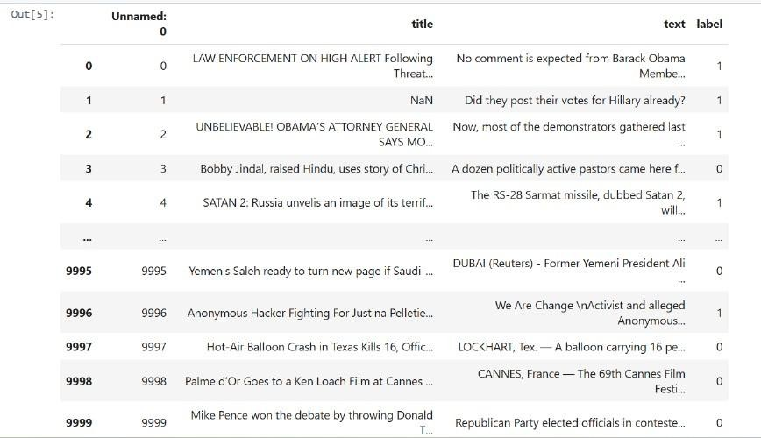
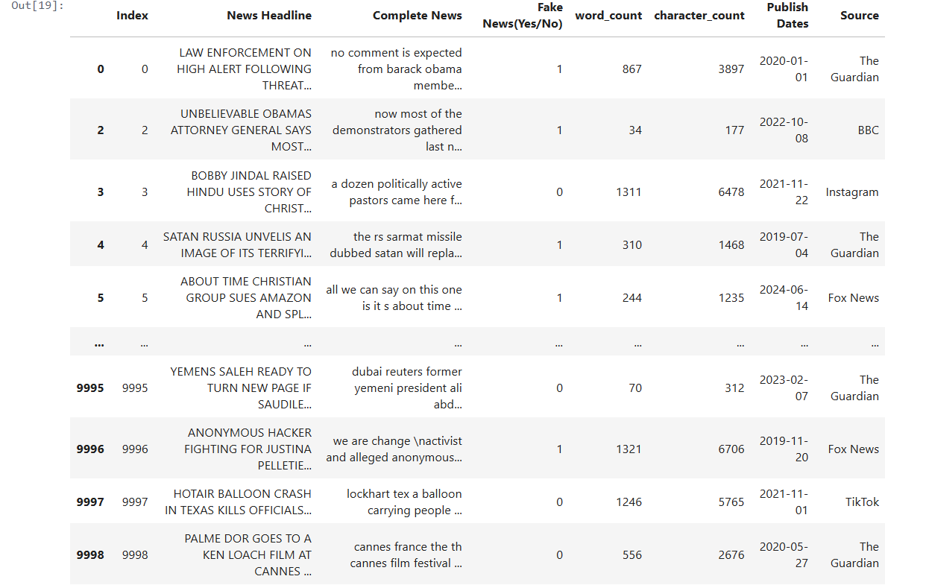
SCREENSHOTS
Before and After

Slide 9
Part 2 – Model Training & Evaluation
Data Split & Vectorization:
Train/Test split: 75/25
TF-IDF and tokenizer applied
Models Used:
Logistic Regression
Decision Tree Classifier
LSTM (Deep Learning) Ensemble: Soft Voting Classifier
Metrics:
Accuracy, Precision, Recall, F1-Score

Slide 10
# Split the dataset into training and testing sets
x_train, x_test, y_train, y_test = train_test_split(x, y, test_size=0.25, random_state=42)
# Text preprocessing and vectorization vectorization = TfidfVectorizer()
x_train_vectorized = vectorization.fit_transform(x_train) x_test_vectorized = vectorization.transform(x_test)
# Tokenization and padding for LSTM
tokenizer = Tokenizer(num_words=10000) tokenizer.fit_on_texts(x_train)
x_train_seq = tokenizer.texts_to_sequences(x_train)
x_test_seq = tokenizer.texts_to_sequences(x_test)

Slide 11
# Logistic Regression model
log_reg = LogisticRegression()
log_reg.fit(x_train_vectorized, y_train)
# Decision Tree Classifier
dt_model = DecisionTreeClassifier() dt_model.fit(x_train_vectorized, y_train)
# LSTM model lstm_model = Sequential([
Embedding(input_dim=10000, output_dim=128, input_length=100), LSTM(128, return_sequences=False),
Dense(1, activation='sigmoid')
])
lstm_model.compile(optimizer='adam', loss='binary_crossentropy', metrics=['accuracy']) lstm_model.fit(x_train_padded, y_train, epochs=5, batch_size=64, verbose=1)
# Predictions for the Ensemble
log_reg_preds = log_reg.predict_proba(x_test_vectorized)[:, 1] dt_preds = dt_model.predict_proba(x_test_vectorized)[:, 1] lstm_preds = lstm_model.predict(x_test_padded).flatten()

Slide 12
# Ensemble: Soft Voting
ensemble_preds = (log_reg_preds + dt_preds + lstm_preds) / 3 ensemble_final_preds = (ensemble_preds >= 0.5).astype(int)
# Classification Reports print("Logistic Regression Report:")
print(classification_report(y_test, (log_reg_preds >= 0.5).astype(int)))
print("Decision Tree Report:")
print(classification_report(y_test, (dt_preds >= 0.5).astype(int)))
print("LSTM Report:")
print(classification_report(y_test, (lstm_preds >= 0.5).astype(int)))
print("Ensemble Model Report:") print(classification_report(y_test, ensemble_final_preds))

Slide 13
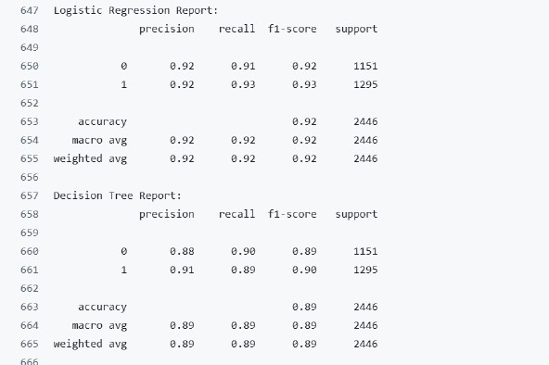
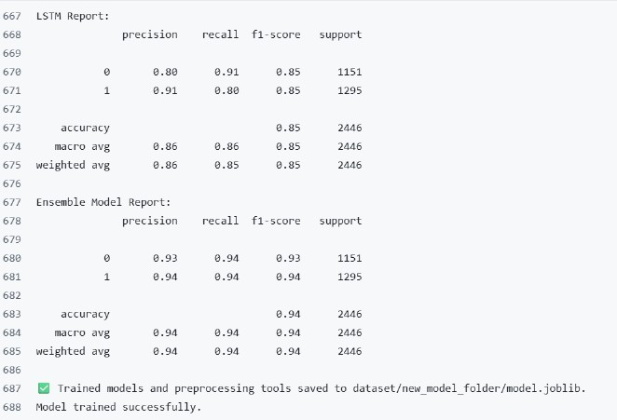

Slide 14
Part 3 – CI/CD Pipeline using GitHub Actions
Goal: Automate training, testing, deployment
Steps:
Set up Python environment
Install dependencies
Clean data
Train & evaluate models
Build Docker image
Push to DockerHub
Run Trivy & CodeQL scans

Slide 15
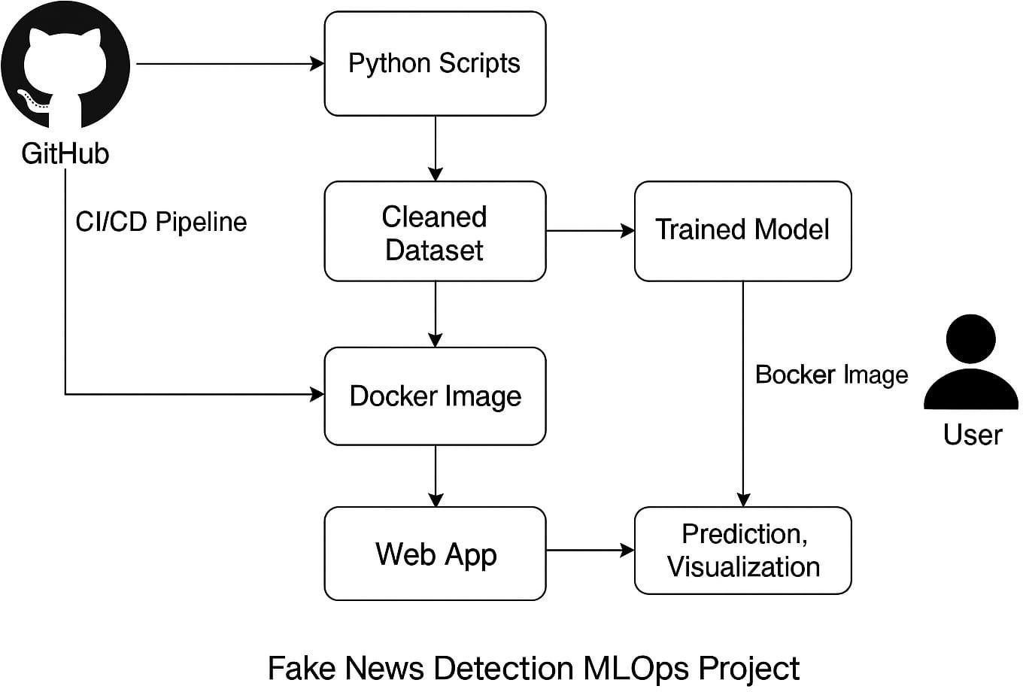

Slide 16
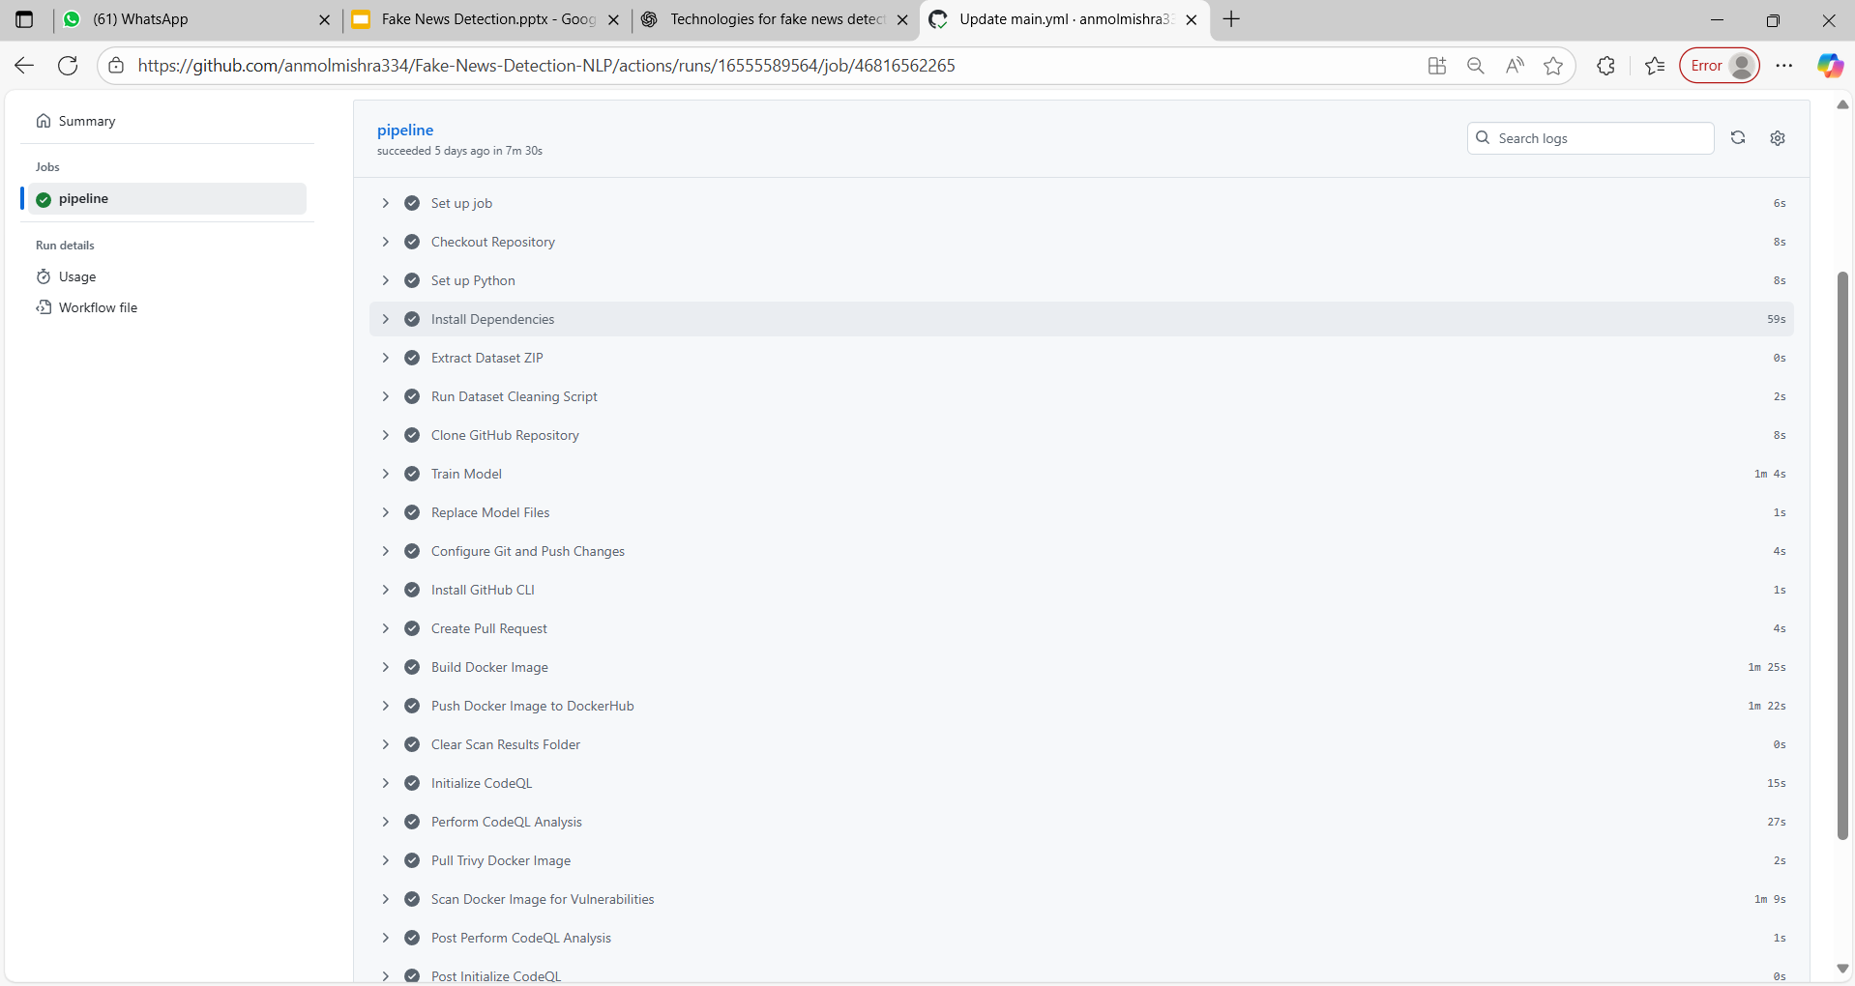

Slide 17
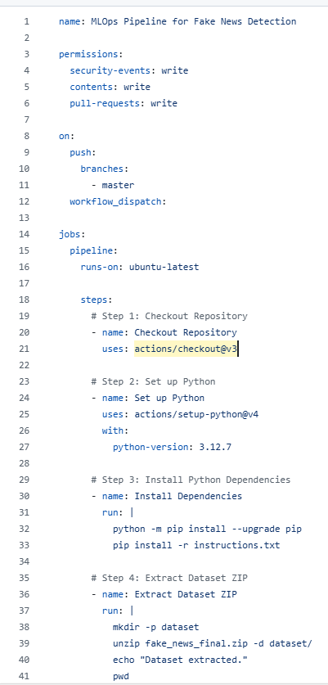
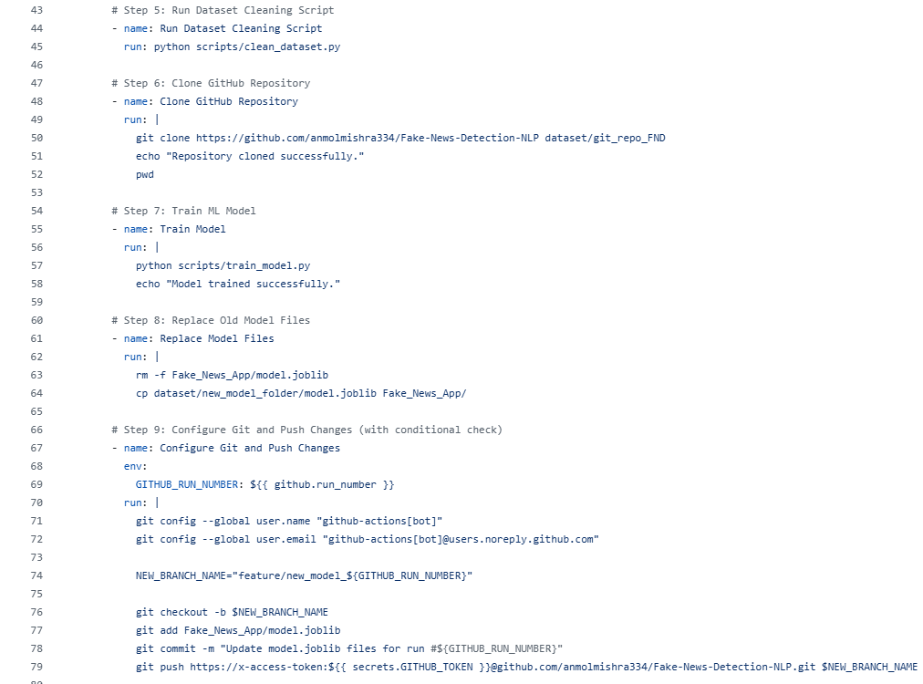

Slide 18
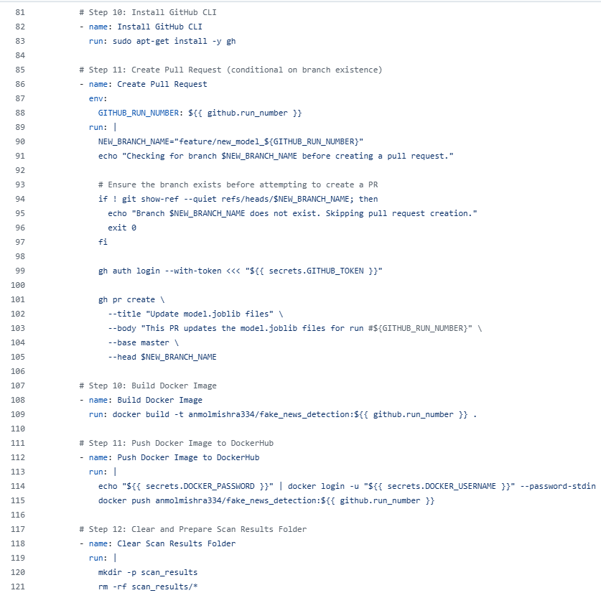
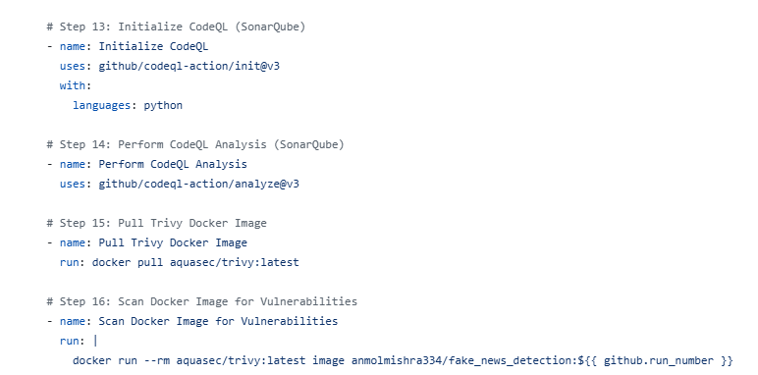
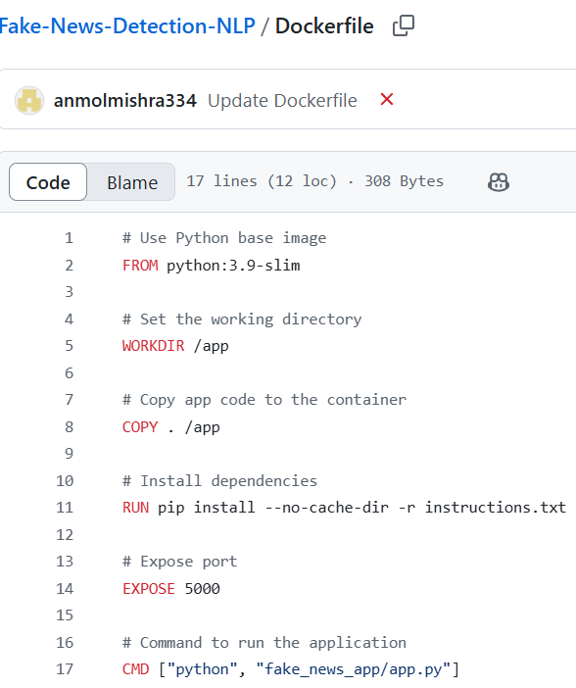

Slide 19
Part 4 – Web Application (Flask)
Functionality:
Input: Single text or CSV file
Output: Prediction with label (Real/Fake)
Backend Functions:
predict_news() – Handles single string input
process_csv() – Processes CSV uploads

Slide 20
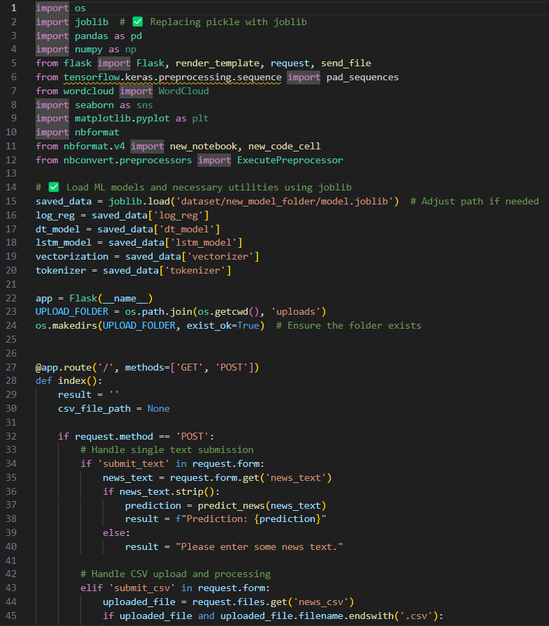
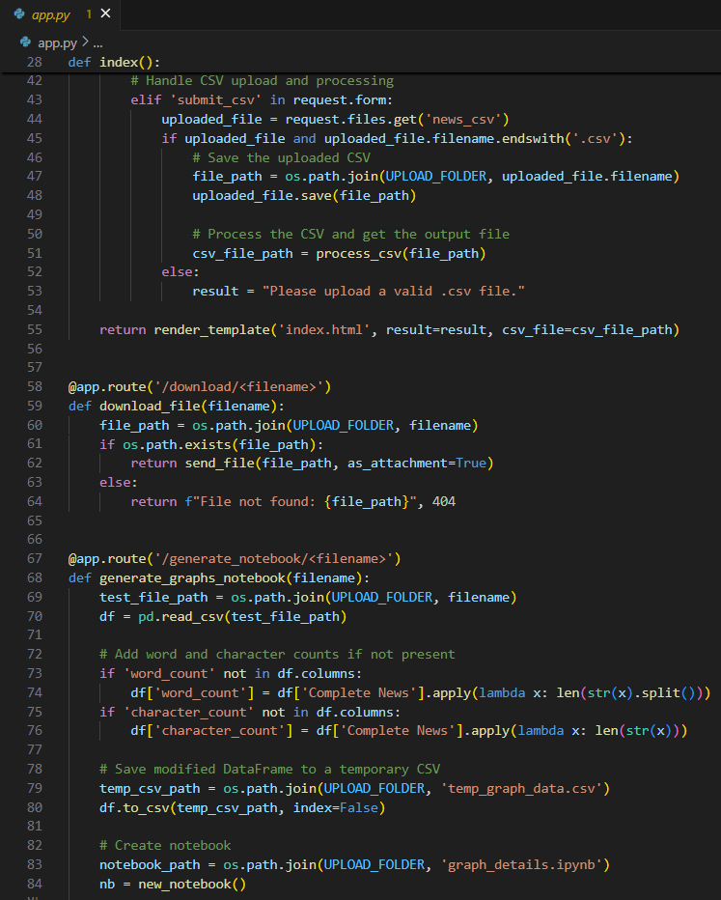

Slide 21
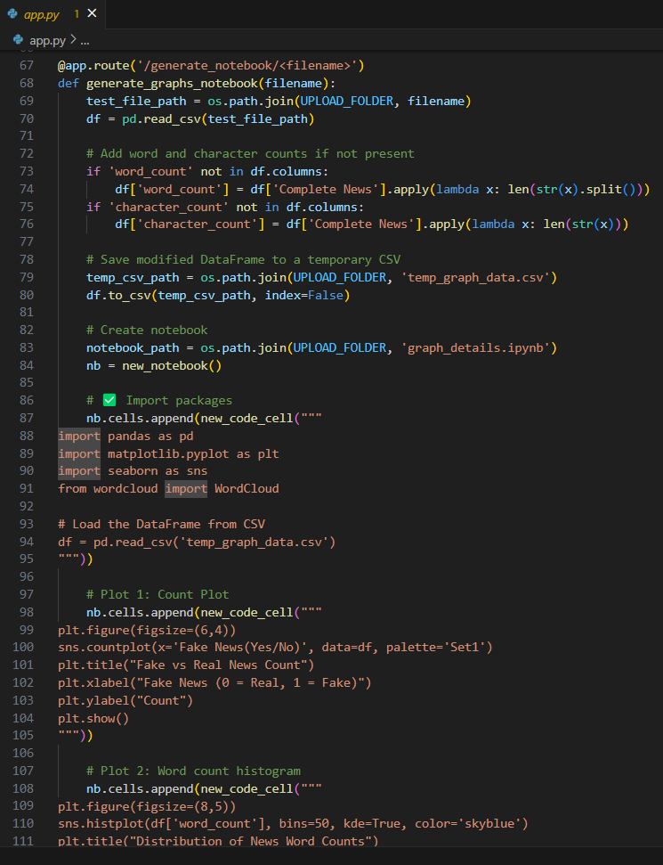
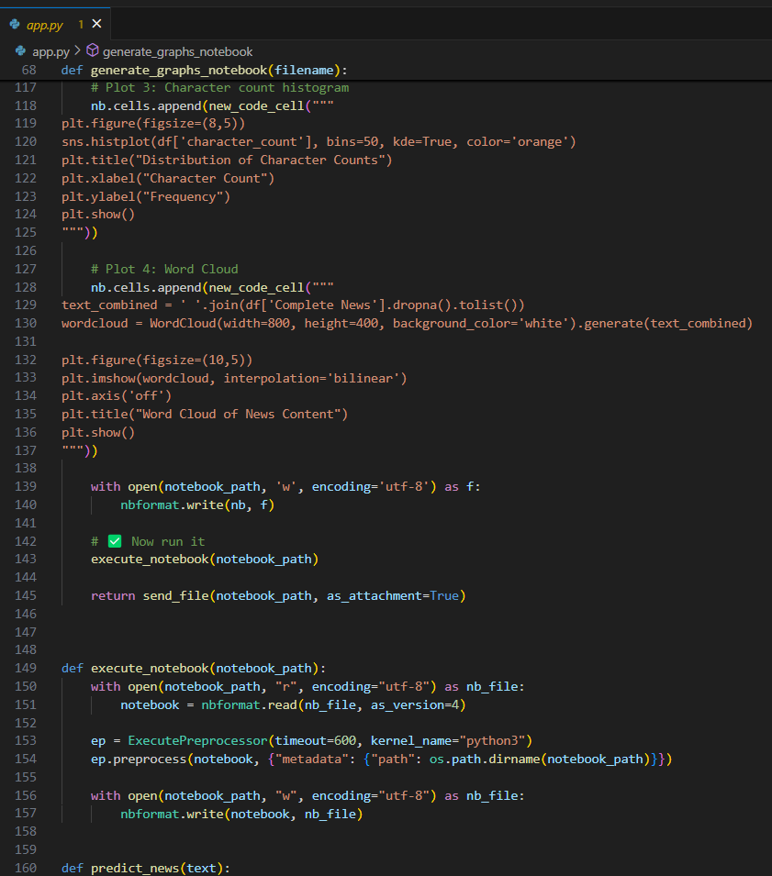

Slide 22
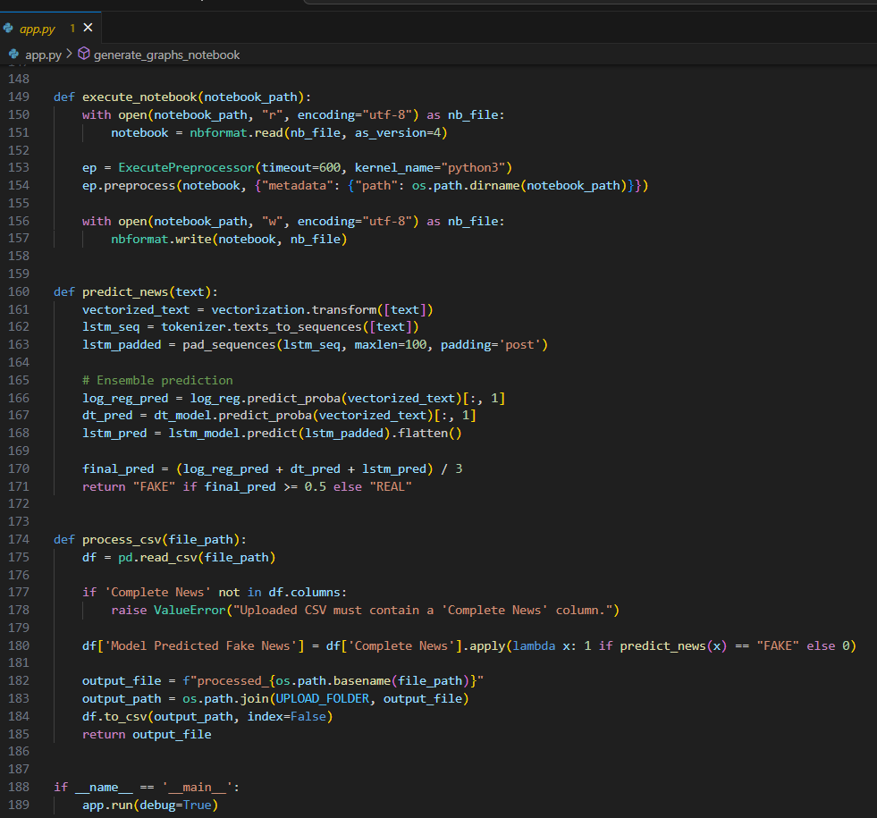
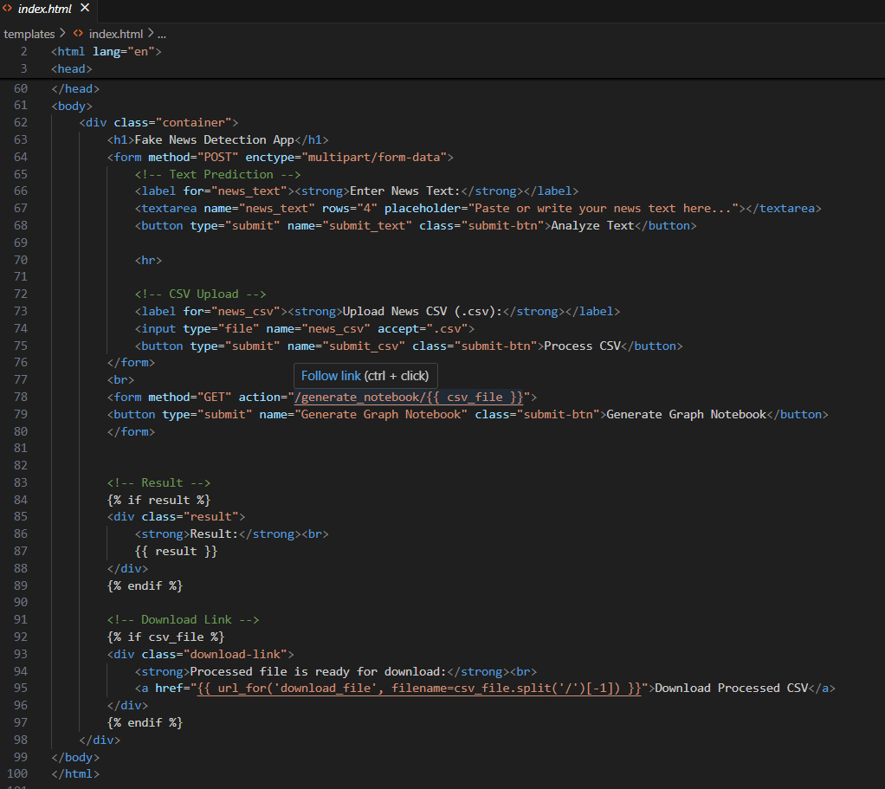

Slide 23
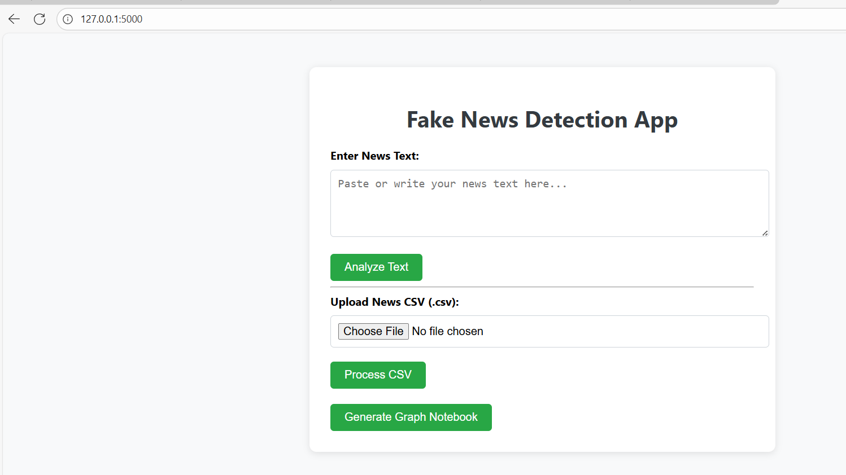

Slide 24
Part 5 – Visualizations
Notebook Generated Automatically:
Word Count Distribution
Character Count Distribution
Word Cloud
Fake vs Real Distribution
Sample Visualization:
Word Count Distribution
Fake vs Real Count

Slide 25
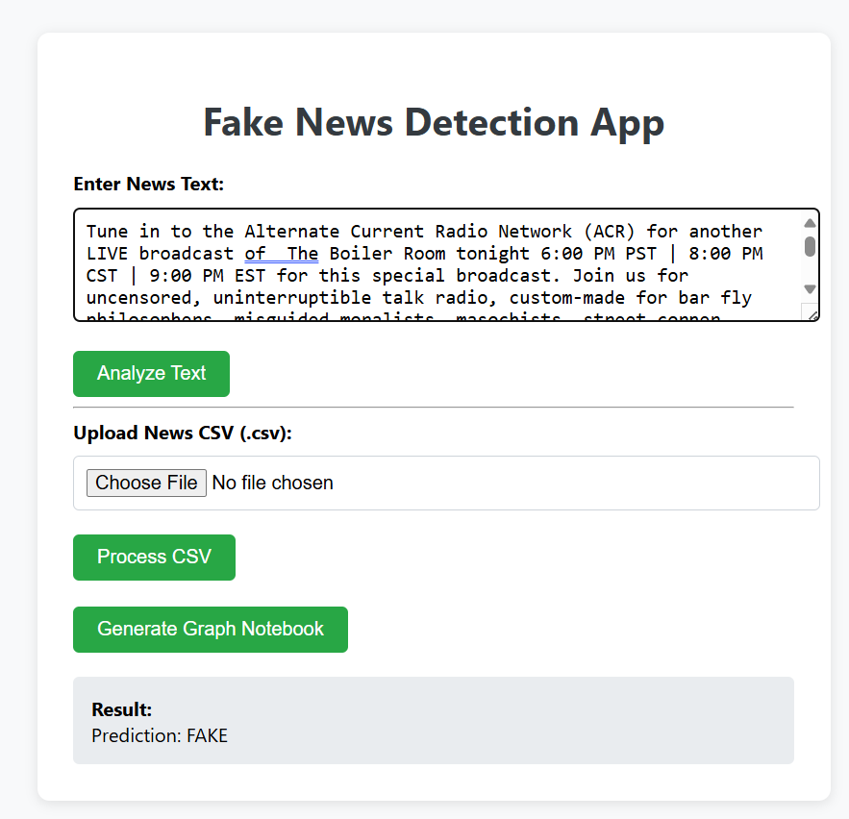
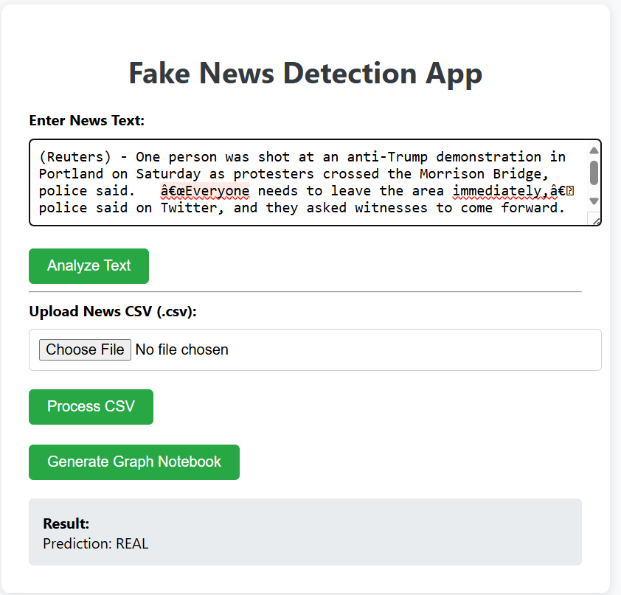

Slide 26
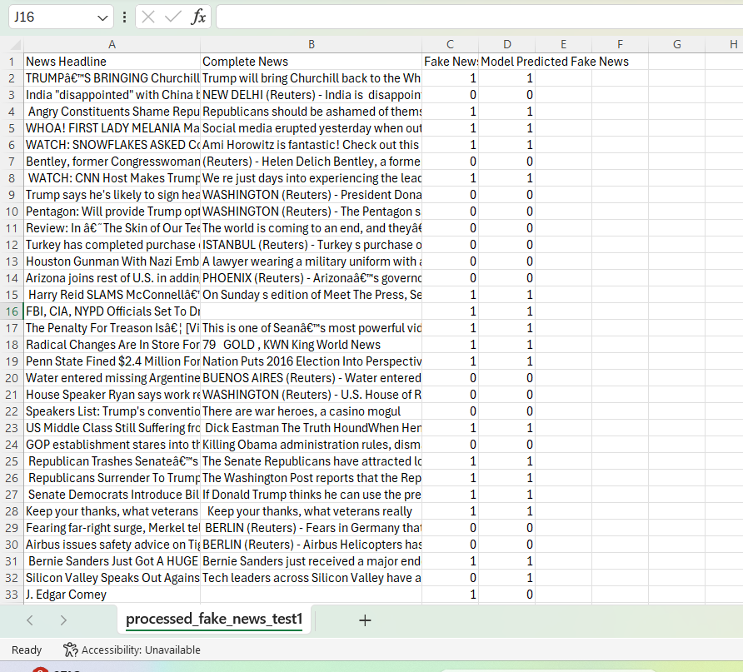
Upload news test csv file and click on submit to get Processed csv file as output available for download processed through ML model.

Slide 27
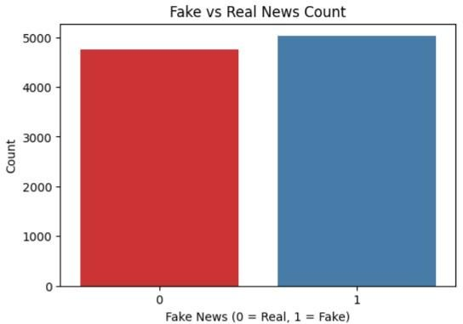
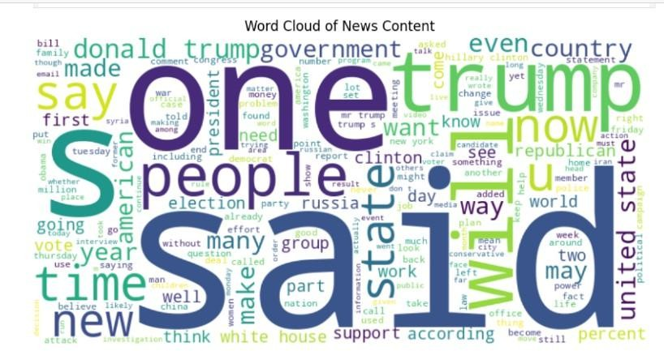
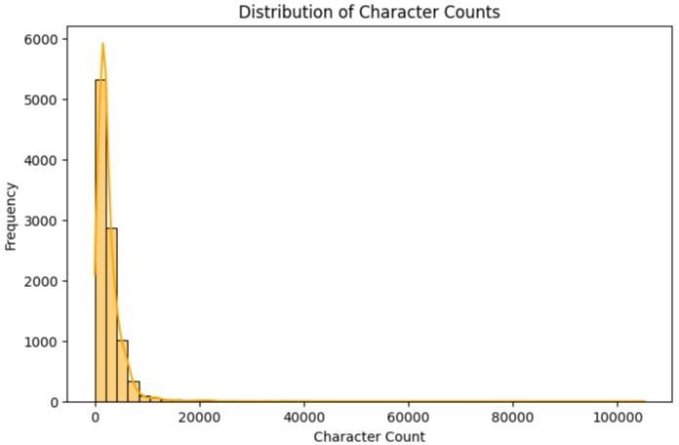
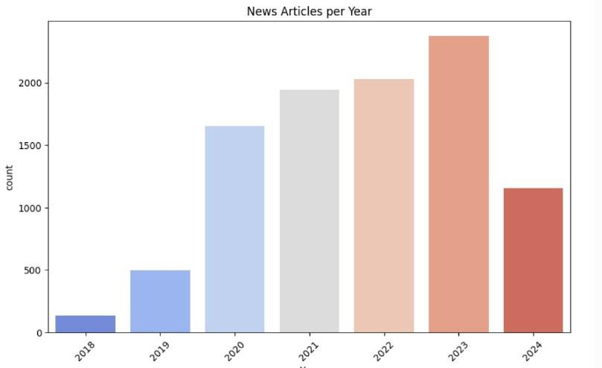

Slide 28
Conclusion
MLOps pipeline fully implemented
Models integrated and deployed automatically
Flask-based accessible UI
GitHub Actions enabled secure deployment

Slide 29
Future Scope
Auto-retraining with time-based scheduler
Deploy on cloud (AWS/GCP)
Add logging and monitoring (Prometheus/Grafana)
Display prediction confidence scores
API testing and unit test integration

Slide 30
Q&A
Any Questions?
Thank you!

